Slide 1
SCMA Block Producer Plant Tour
AIA provider # G030 AIA course # Blk 2020

Slide 2
SCMA Block Plant Tour
This program is registered with the AIA/CES for continuing professional education. As such, it does not include content that may be deemed or construed to be an approval or endorsement by the AIA of any material of construction or any method or manner of handling, using, distributing, or dealing in any material or product. Questions related to specific materials, methods, and services will be addressed at the conclusion of this presentation.
Please note this AIA Continuing Education Program offers:
1 LU/HSW Credit Hour (Health, Safety, Welfare)

Slide 3
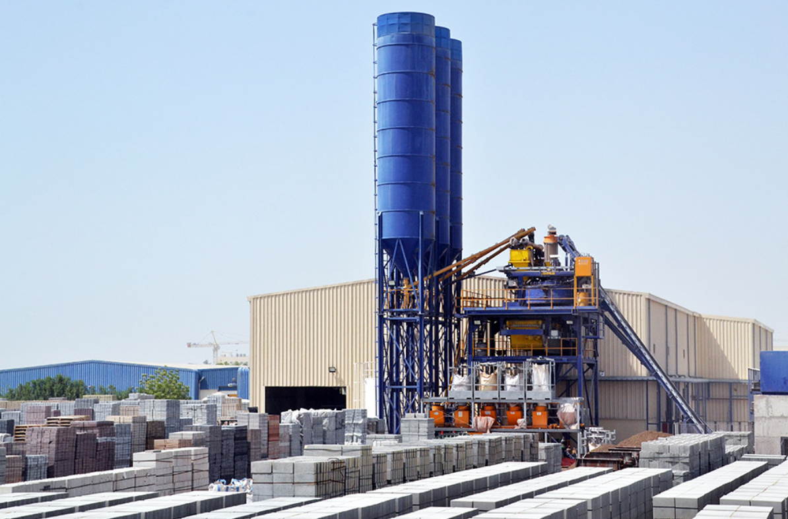
SCMA Block Plant Tour
Participants will learn first-hand through instruction and observing the manufacturing process how concrete masonry and hardscape units are made. Additionally because of the highly specialized process and equipment used in their manufacture, concrete masonry units are structurally sound and sustainable construction products

Slide 4
Learning Objectives
Recognize that all unit shapes are designed to obtain the most structural benefit.
Understand how concrete masonry and hardscape products when combined with mortar, grout, reinforcing steel, or geosynthetics form a cohesive, strong structural assembly that can effectively resist the design loads.
Understand that through the use of extremely high pressure and vibration, very strong, durable and sustainable concrete masonry and hardscape products are made with low cement and low water content.
Understand that concrete masonry and hardscape products are noncombustible and that fire resistance rating of a masonry block assembly easily can be determined according to the amount of material and the aggregate type used in the manufacture of the unit.

Slide 5
Guidelines for Safety First Program
Review each of the following plant-specific procedures with each visitor prior to the CMU producing site tour.
Cell Phone/PDA use is restricted to offices, break rooms and posted areas. Absolutely no cell phone inside Block Plant!
Personal Protective Equipment required:
Hard Hat
Safety Glasses
Minimum No open toe shoes. Prefer Safety “steel toe” shoes
High Visibility Apparel
Ear Protection

Slide 6
Guidelines for Safety First Program
If accident occurs:
Immediately report to tour guide or available plant employee.
Walking paths and access areas:
Remain in marked pedestrian areas unless accompanied by a plant employee.
Recognize exits and evacuation designated areas
Forklift and truck traffic:
Remain alert & aware of truck, tractor and forklift traffic at all times. Stay out of their way.
Stop, look, listen at all stop signs, intersections, blind spots.
Equipment and Machinery:
Do NOT enter any machinery area, open or bypass and any equipment guarding.

Slide 7
Guidelines for Safety First Program
SCMA Safety First Program Final Points
Be aware of your surroundings at all times!
Have Fun while learning about our products!
The SCMA Safety First Motto
Never Give Safety A Day Off!

